Slide 1
Sales Performance Analysis – Zepto (Milestone 1 Project)

Slide 2
agenda
Project Introduction
Data Cleaning and Preparation
Data Import into MySQL
SQL Queries & Dashboard Creation
Conclusion & Takeaways
Business Insights

Slide 3

Project introduction
Milestone 1: Advanced Excel & SQL Integration
This project focuses on analysing Zepto’s product-level sales data across major Indian cities using a combination of SQL queries and Excel dashboards. The goal is to uncover actionable insights into revenue trends, discount strategies, and the impact of influencer-driven sales.

Slide 4

Data Cleaning and Preparation
Handling duplicates - Removed duplicates from dataset
Standardizing categories - Standardized product categories and city names
Calculating discounts - Verified and corrected discount calculations
Verifying influencer flags - Ensured 'Influencer Active' field is consistent (Yes/No)

Slide 5
Data Import into MySQL
Used MySQL Workbench to create 'zepto_dataset' database
Imported Excel data using CSV export and LOAD DATA INFILE
Table schema includes: Product Name, Category, City, Prices, Orders, Revenue, Influencer Flag
A Separate SQL queries are documented for below,
Total Revenue: SELECT SUM(`Total Revenue`) FROM zepto_sales_dataset;
Total Orders: SELECT SUM(`Orders`) FROM zepto_sales_dataset;
Influencer Revenue: SELECT SUM(`Total Revenue`) WHERE `Influencer Active` = 'Yes’;
City-wise Revenue: SELECT City, SUM(`Total Revenue`) GROUP BY City;

Slide 6
SQL Queries & Dashboard Creation

Slide 7
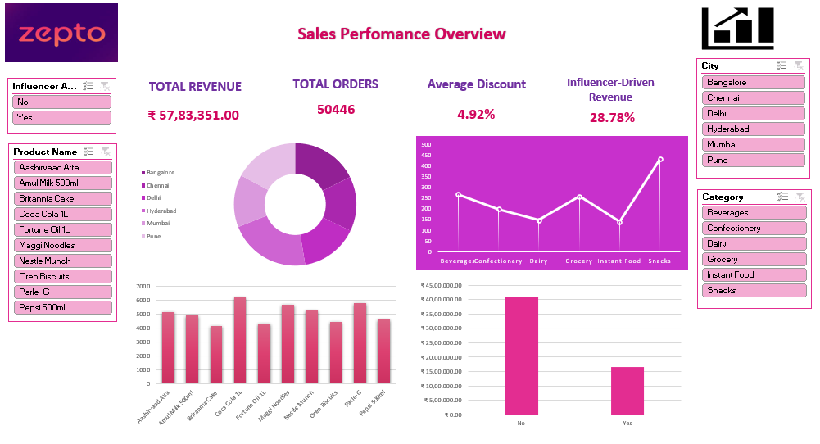

Slide 8

Conclusion
Total revenue analyzed: ₹57,83,351 across 300+ product-level entries
Influencer-driven sales contributed ₹16,64,472 — accounting for 28.78% of total revenue
Top-performing cities📍: Hyderabad, Bangalore, and Pune
Leading categories: Snacks, Beverages, and Grocery
As Project Outcome Excel-SQL integration enables real-time, dynamic refreshable dashboards 📊 with slicers, KPI🎯 cards, and charts.

Slide 9
takeaways
Influencer Impact is Significant: Products tagged “Yes” for influencer activity showed strong revenue performance
City-Level Strategy is Crucial: Regional trends highlight where marketing and inventory should be optimized
Category Trends Drive Decisions: Snacks and Beverages consistently outperform others in volume and revenue
Data Integration Matters: ODBC connectivity enabled real-time updates and scalable analysis

Slide 10
BUSINESS INSIGHTS💡
Influencer-driven sales contributed ₹16,64,472 (28.78%) of total revenue. Strongest impact seen in Pune and Bangalore, suggesting expansion of influencer partnerships in these cities.
Hyderabad, Bangalore, and Pune are the top-performing cities by revenue. These regions should be prioritized for inventory stocking and targeted promotions.
Snacks, Beverages, and Grocery dominate both sales volume and revenue. Marketing spend and bundling strategies should focus on these categories to maximize ROI (Return of Investment).
Discounts vary widely across cities and products. Standardizing discount policies or targeting them strategically can improve margins without hurting demand.
High-performing products include Britannia Cake, Pepsi 500ml, and Maggi Noodles. These can anchor promotional bundles, loyalty programs, or influencer-driven campaigns.
Influencer Campaign Effectiveness
City-Level Performance
Category Trends
Discount Optimization
Product Insights

Slide 11
Thank you
Presented by,
Sangeetha .S

